Slide 1
Moving away from Limited Resources
Adrien A. Hammoud
Ralph E. Daher

Slide 3
Reasons
Limited resources will run out eventually
Limited resources are endangering the environment
Limited resources are no longer needed with new energy saving technologies

Slide 4
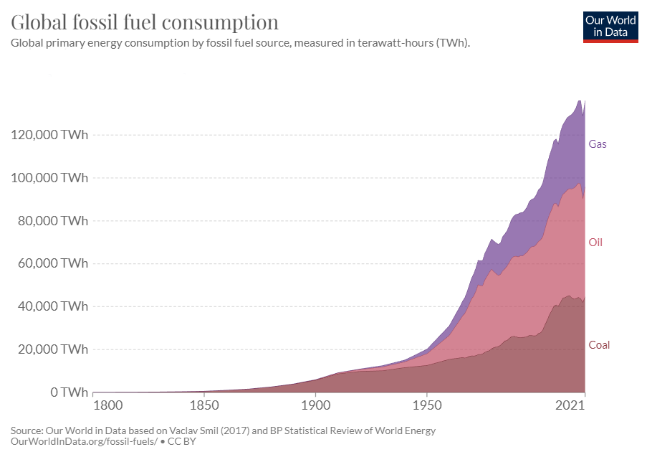
Limited Resources Will Run Out Eventually
Increasing global consumption:
70,600 TWH in 1980
136,018 TWH in 2021

Slide 5
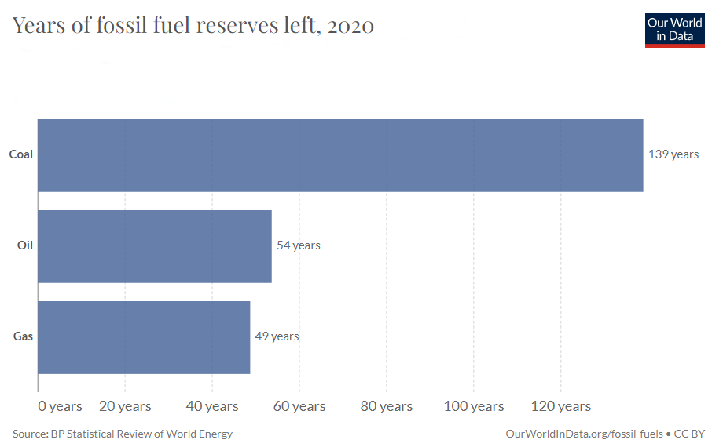
Limited Resources Will Run Out Eventually
Our reserves are running low:
139 years of coal reserves left
54 years of oil reserves left
49 years of gas reserves left

Slide 6
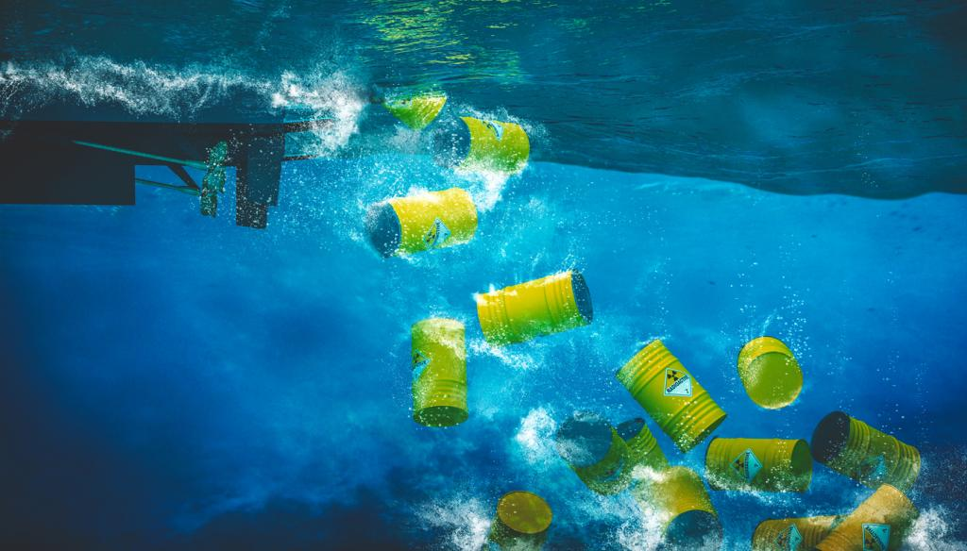
Limited Resources are Endangering the Environment
Carbon dioxide emissions caused by the combustion of fossil fuels over the years
Radiation leakage caused by nuclear reactors that release radioactive materials

Slide 7
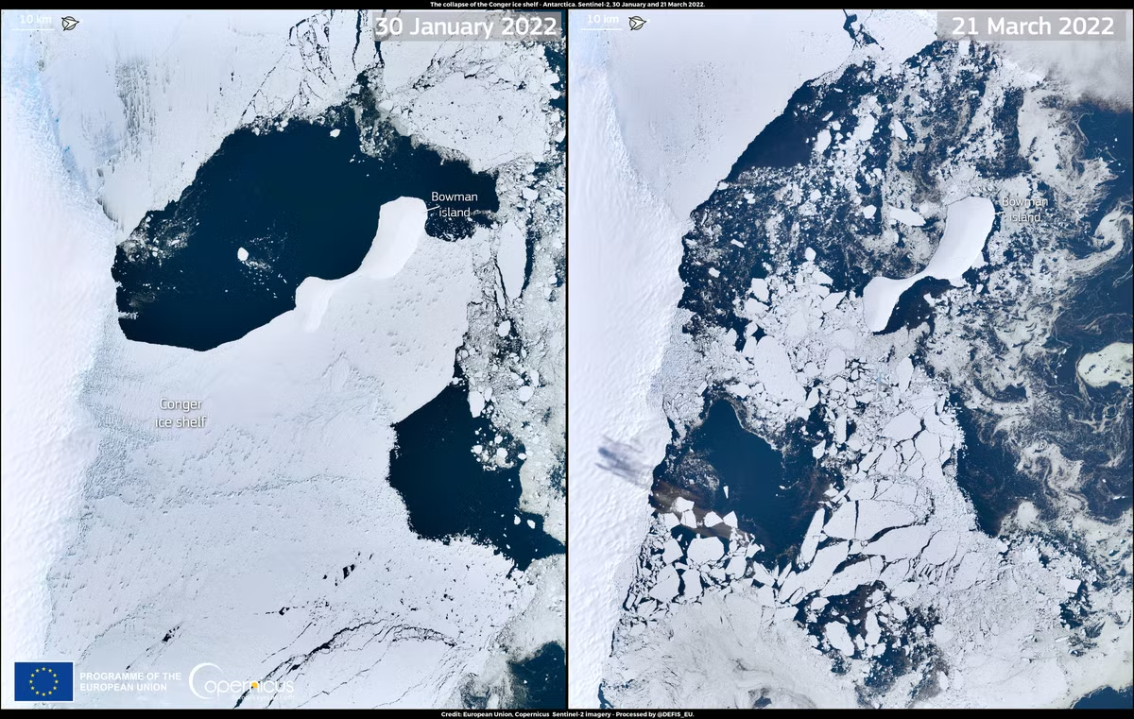
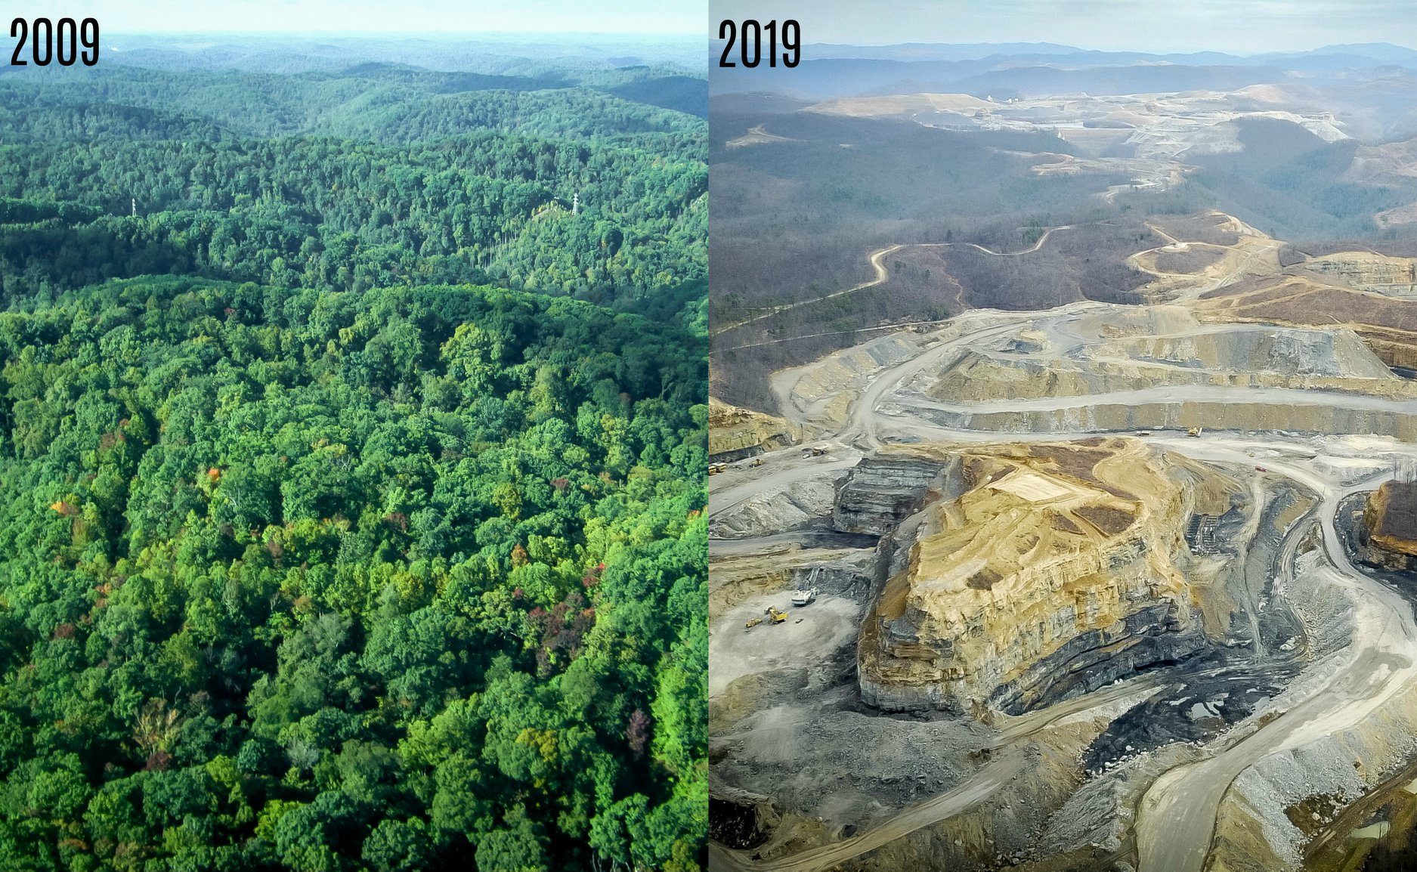
Limited Resources are Endangering the Environment
Extracting these limited resources results in deforestations and removal of mountaintops
Excessive use of these limited resources causes global warming making it harder for polar species to live

Slide 8
Limited Resources are No Longer Needed With New Energy Saving Technologies
Examples of new technologies:
Electric cars
LED lights
New computer chips
Why do they eliminate the need for limited resources ?
They do not require a lot of energy to function
They do not dissipate a lot of energy as heat

Slide 9
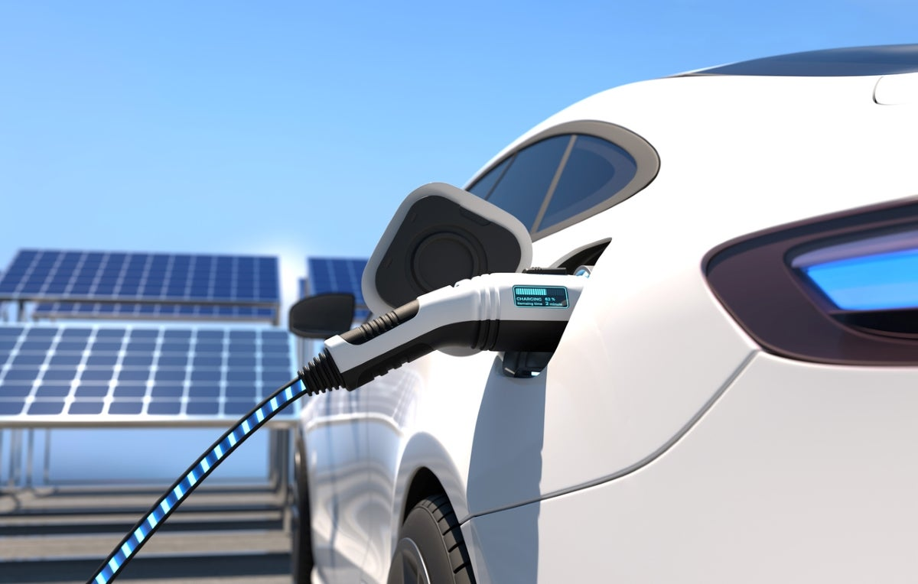
Electric Vehicles in Energy Saving
How does it save energy ?
It can convert up to 80% of the input energy to the wheels
It can be recharged for daily use with a renewable source such as solar panels

Slide 10
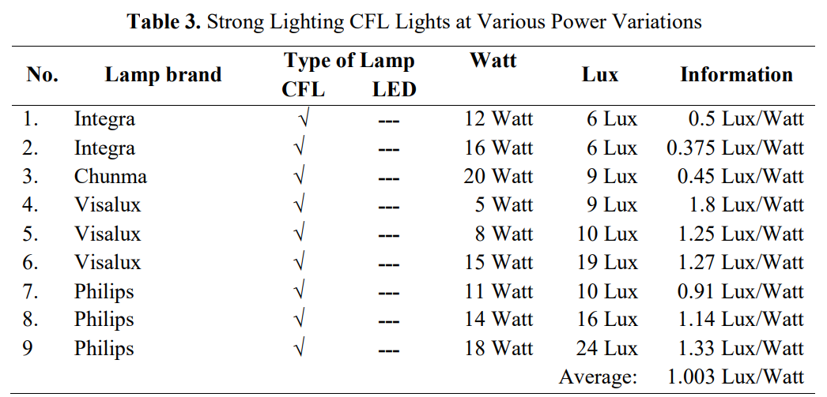
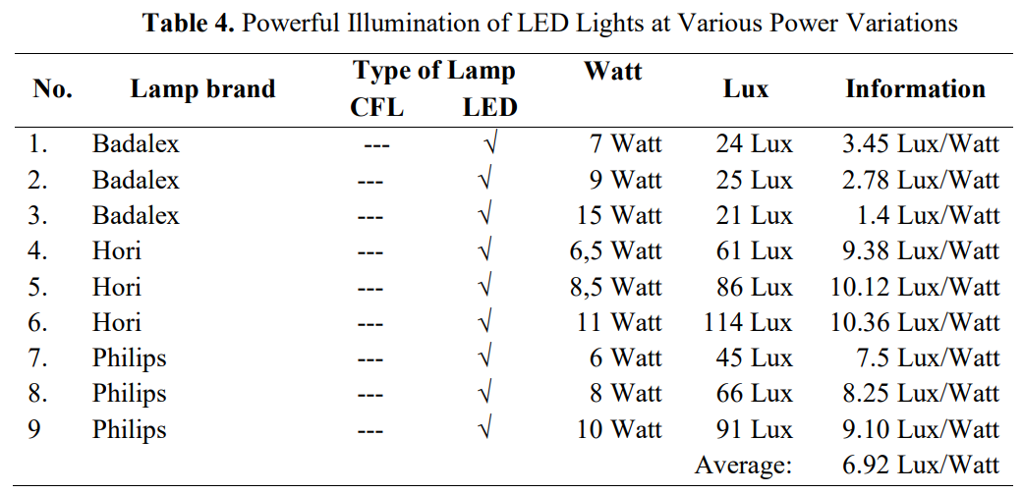
LED Lights in Energy Saving
Performance comparison:
A Philips 10-Watt LED light emits 91 Lux
A Philips 11-Watt CFL light emits 10 Lux only
The difference between averages shows that LED lights are more economic and have better performance.
Hudallah, N., Isdiyarto, Sukamta, S., Nashiroh, P. K., Harlanu, M., & Purbawanto S. (2021). Comparison of CFL lights and led lights reviewed from the side of the price, strong light and heat caused. IOP Conference Series. Earth and Environmental Science, 700(1).

Slide 11
New Computer Chips in Energy Saving
Why are newer chips more efficient ?
They are made with ferroelectric material to increase efficiency and reduce heat
They can perform all sorts of tasks eliminating the need for multiple processors inside the same device

Slide 12
Is This Transition Possible at the time ?
Some people point out that:
This transition is going to be expensive
This transition will take years to be accomplished globally
However:
Renewables require less maintenance over the years
Renewables only have installation fees (no monthly payments)

Slide 14
References
Hansen, J., Kharecha, P., Sato M., Masson-Delmotte, V., Ackerman, F., Beerling, J. D., Hearty, J. P., Hoegh-Guldberg, O., Hsu, S., Parmesan, C., Rockstrom, J., Rohling, J. E., Sachs J., Smith, P., Steffen, K., Van Susteren, L., von Schuckmann, K., & Zachos, C. J. (2013). Assessing “Dangerous Climate Change”: Required Reduction of Carbon Emissions to Protect Young People, Future Generations and Nature. Plus One, 8(12). https://doi.org/10.1371/journal.pone.0081648
Hazra, G. (2018). RADIOACTIVE POLLUTION: AN OVERVIEW. The Holistic Approach to Environment, 8(2), 48-65. https://www.proquest.com/docview/2060920495/abstract/D4CCABB0A0FA4513PQ/1?accountid=171287
Hudallah, N., Isdiyarto, Sukamta, S., Nashiroh, P. K., Harlanu, M., & Purbawanto S. (2021). Comparison of CFL lights and led lights reviewed from the side of the price, strong light and heat caused. IOP Conference Series. Earth and Environmental Science, 700(1). https://doi.org/10.1088/1755-1315/700/1/012014

Slide 15
References
New material for computer chips could reduce energy consumption. (2023, February 15). National Science Foundation. https://beta.nsf.gov/news/new-material-computer-chips-could-reduce-energy
Nuclear power and the environment. (2022, November 7). U.S. Energy Information Foundation. https://www.eia.gov/energyexplained/nuclear/nuclear-power-and-the-environment.php
Office of energy efficiency & renewable energy. (n.d.). All-electric vehicles. Fueleconomy. https://www.fueleconomy.gov/feg/evtech.shtml
Ritchie, H., Rosado, P., & Roser, M. (2022). Energy. Our World in Data. https://ourworldindata.org/energy
Toh, L. (2021, October 26). Let’s come clean: the renewable energy transition will be expensive. Columbia Climate School Climate, Earth, and Society. https://news.climate.columbia.edu/2021/10/26/lets-come-clean-the-renewable-energy-transition-will-be-expensive/

